Slide 1
Cryptology Past-Present -future

Slide 2
Cryptology Past-Present -future
Saeed seyedaghaBanihashemi
School of intrenational relations of Ministry of forigen affairs of Iran
Embassador of I.R.Iran in Hungary
–Budapest
embiran@nextra.hu
www.ircypt.com

Slide 3
Introduction: To ability to communicate has always been a key aspect in the acquisition of knowledge and the evolution of the humanity. The need to convey a massage in a secure way a probably as old as communication itself. Historically it was during conflicts between nations That this was the most necessary.
In our modern world where many communication media are used routinely the need for privacy is more of an issue then ever in a great variety of applications

Slide 4
Software companies wishes to protect their products against piracy ,banks wants to ensure secure transactions and almost every one whishes to keep their personal information private. The need for secure communication gave rise to a science referred to as cryptology.
Cryptology
A cipher system or cryptosystem is a technique used
to hide massage from unit intended recipients.Cryptology is the science that creates those cryptosystems.

Slide 5
Crypto analysis is art of unraveling or breaking such system ,that is reading them even if one is not the intended recipient. The cryptology is used to encompass both cryptology and crypto analysis.

Slide 8
Creation of Science cryptology
Egypt civilization
Greece civilization
Indian civilization
Islamic civilization
European civilization
The original massage which is to be sent is called the plane text. The encrypted massage is called cipher text. Encryption is the process of transforming the plaintext into cipher text , typically by using an algorithm and a key.

Slide 9
A key is a component which shared secretly by the both the sender and recipient and may vary from one massage to another. Decryption is process of transformation the cipher text. This reverse process is typically derived from the knowledge of the encryption algorithm and the key.
Example:
Plane text =521 key =122 algorithm =+(addition )
Algorithm(+)
521
521+122
643
key122

Slide 10
System of Cryptography
a)A key
b)Symmetric
c) Asymmetric
Goal of cryptography system
a)Confidentiality
b)Integrity
c)Authenticity
Application
a)Secure communication
b) Data base and file security
c)Data e-transmit
d)e- commerce
e) e-cash
f)Contract signing
g) e-mail
………..

Slide 11
A system of cryptography

Slide 12
Logical Model of a General Stream Cipher
XOR
01101011
11001110
Plain text
Cipher text
1001
10100101
Key generator
Uniform Secret Key
Key stream
12

Slide 13
A Simple Example
Vernum Cipher is a stream cipher .
A binary message m[1],m[2],…,m[t] is operated by a binary key stream k[1],k[2],…,k[t] of the same length to produce cipher text
c[1],c[2],…,c[t] Where for each i=1,2,…t c[i]=k[i] m[i]
Encryption
Decryption
Plaintext
100…….
Plaintext
110…….
Cipher text
110…….
010 ..
010 ..
K
K
In design a general Stream Cipher,
usually we consider a One Time Pad which uses a short uniform secret key.

Slide 14
Classical Cryptography
E:set of function key
Decipher:
The function must be one- to- one
Definition :
We call it convergent if:

Slide 15
Transformation Cryptography
CEASAR
FDHVDU
For deciphering alkandi method used

Slide 16
Alkandi one of the galaxy of the Islamic mathematician
which for first time made a cryptography Academy (15th A.D)
His book is sobh alahsa. We can see his manuscript about
Attacking the transfotamtion cipher.

Slide 17
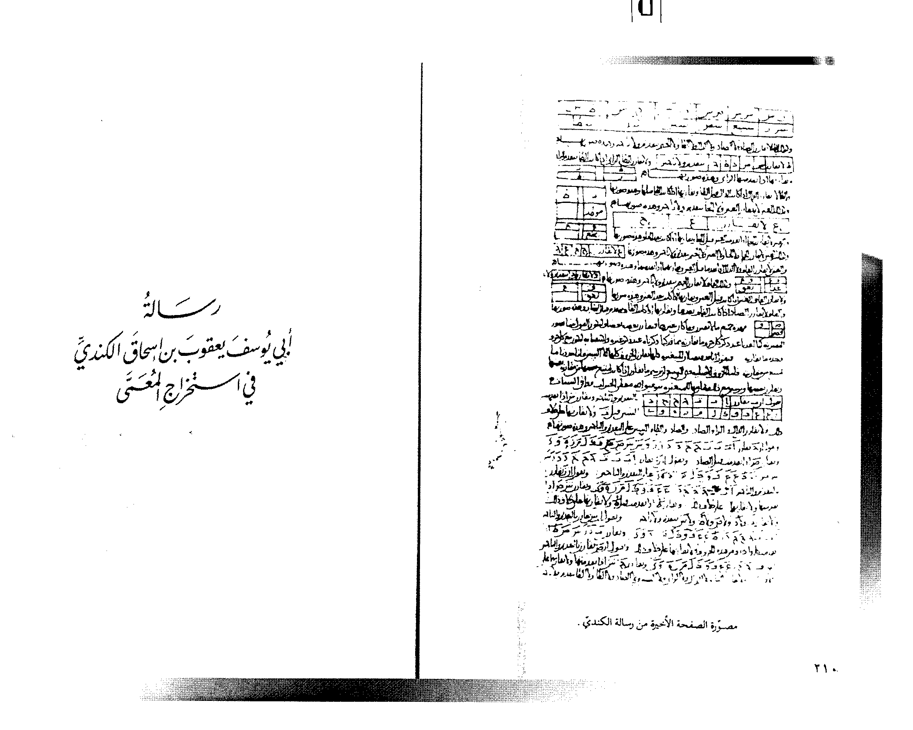

Slide 18
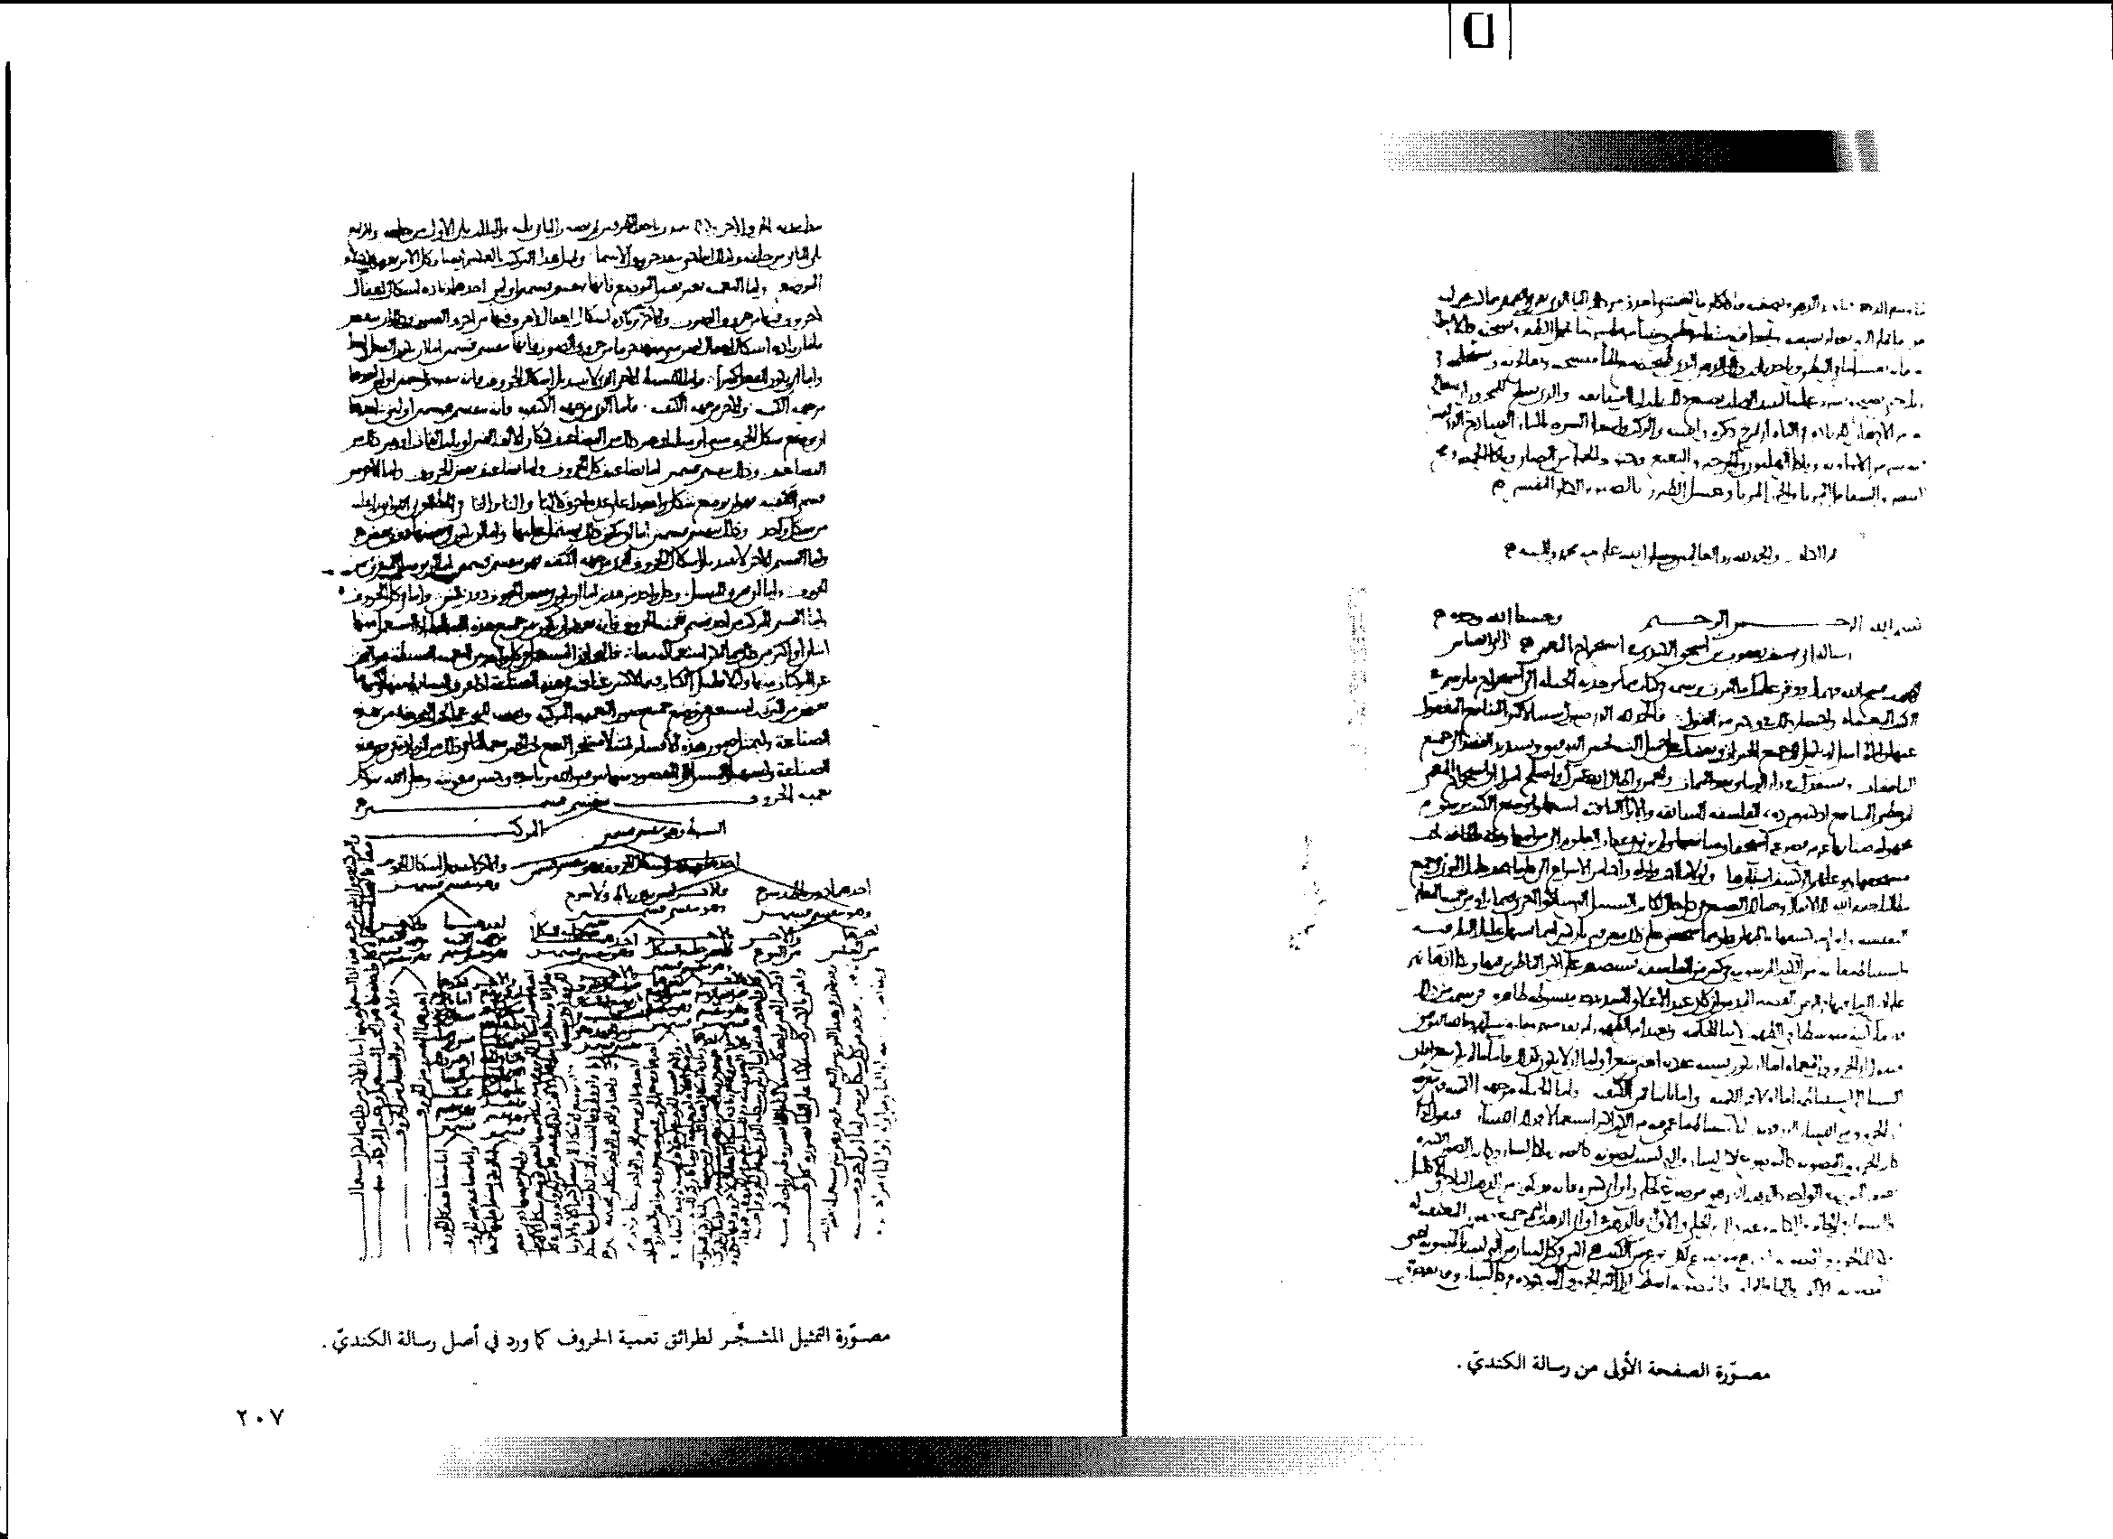

Slide 19
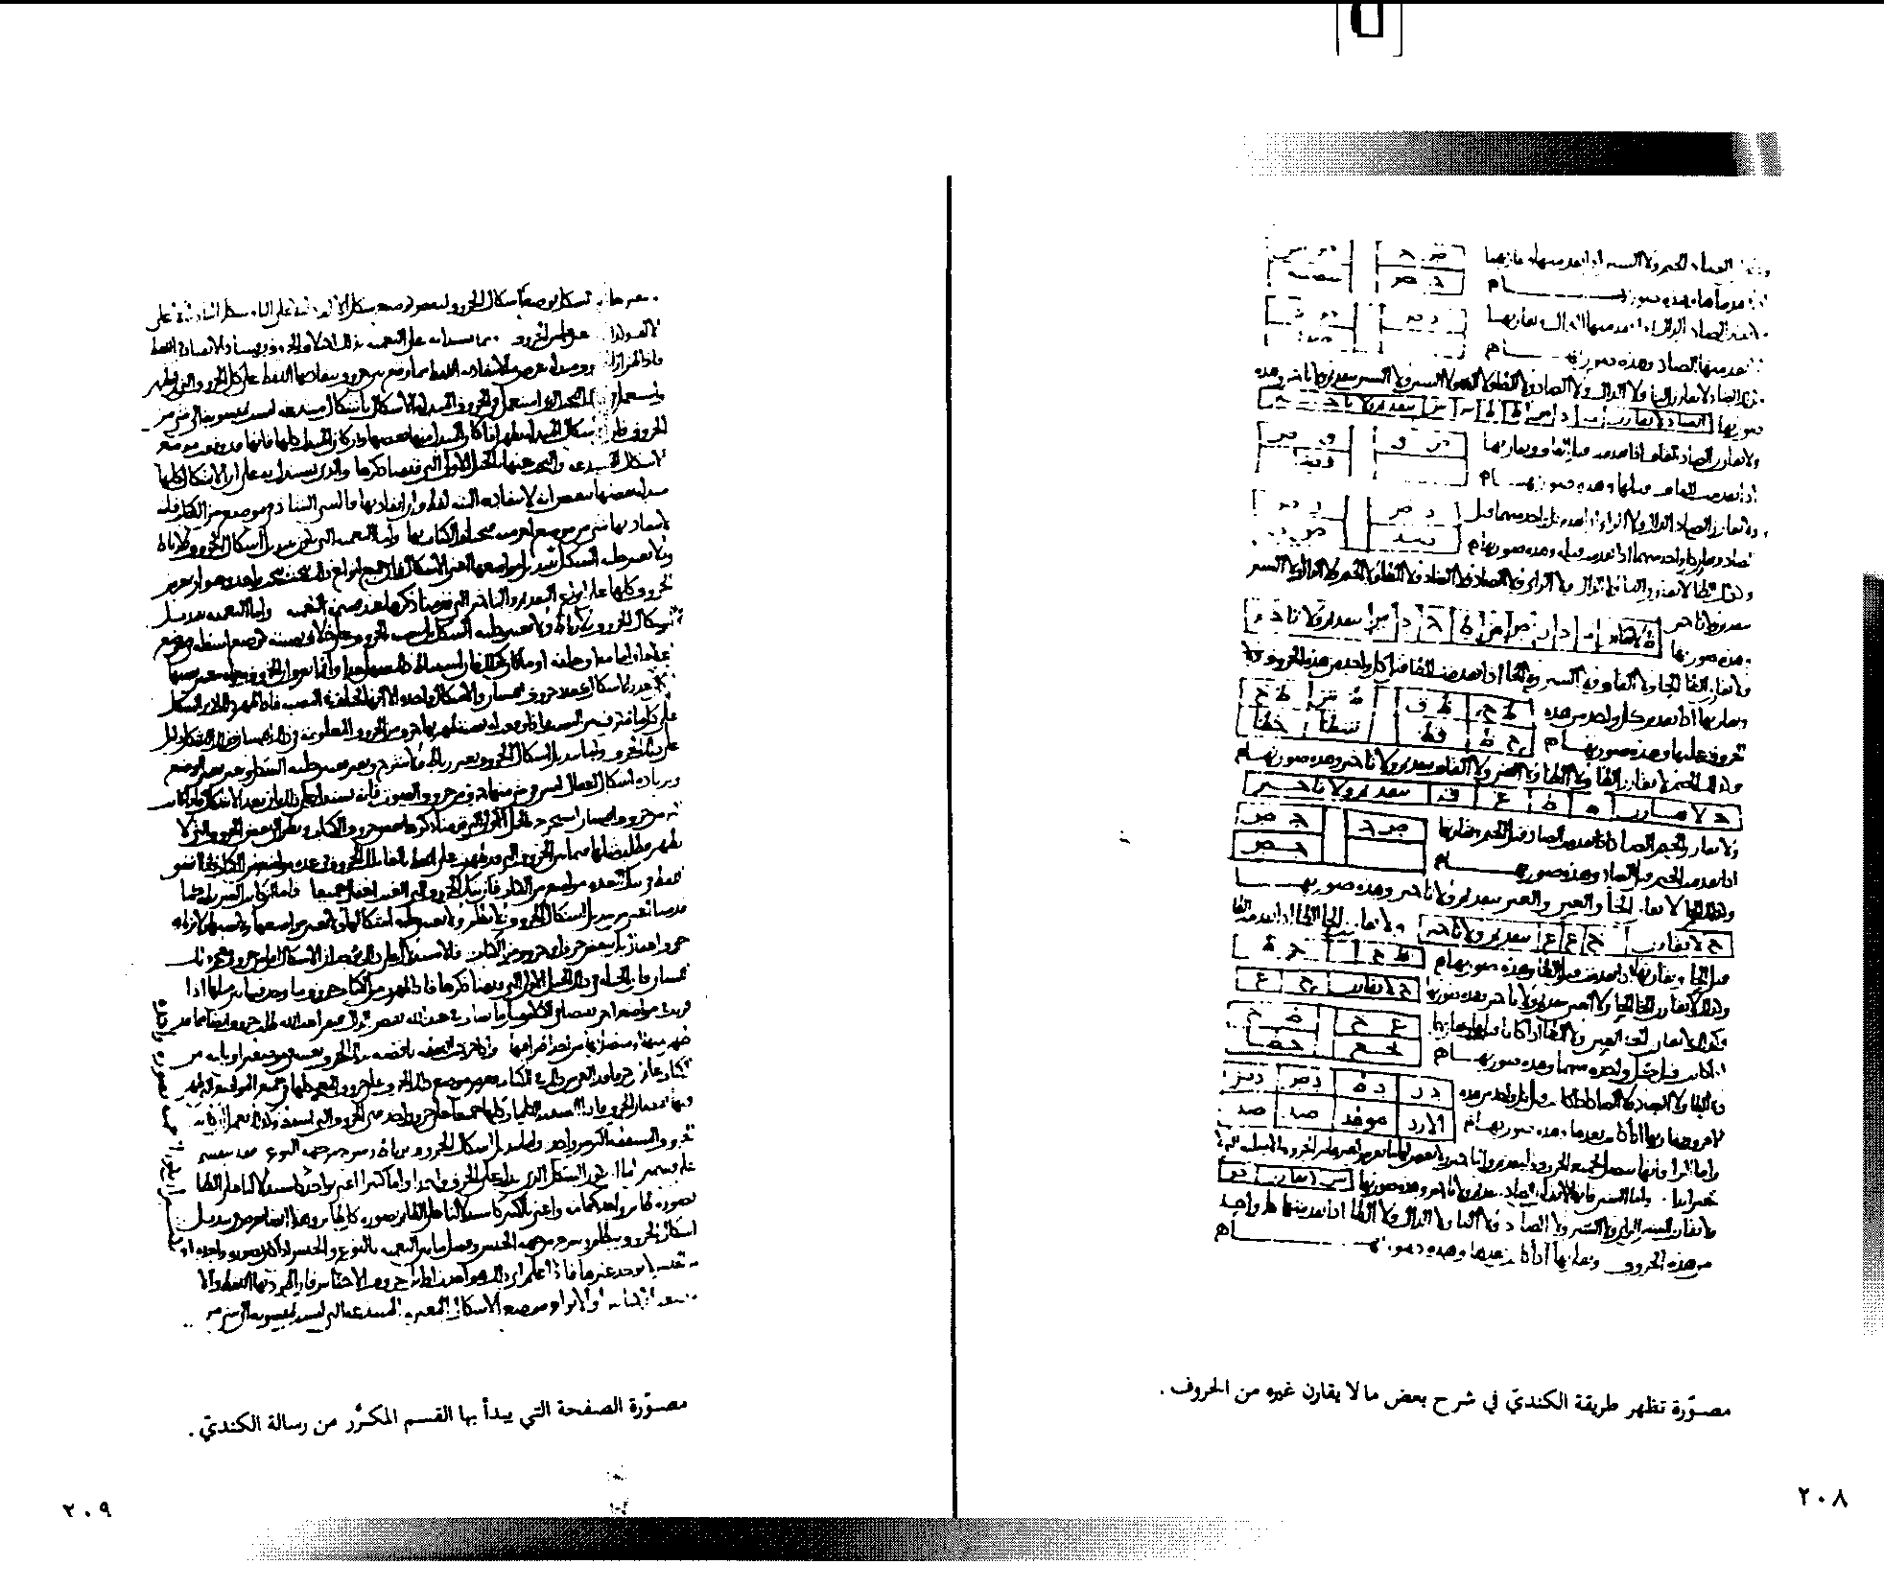

Slide 21
Second example is document belong to Vatican
diplomat serving in polish 1573.

Slide 22
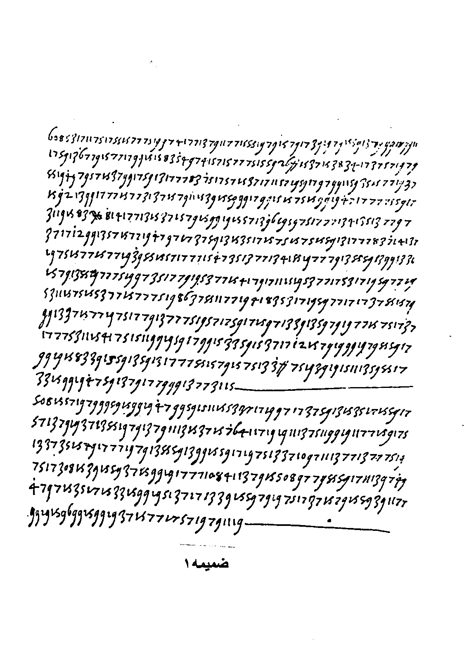

Slide 23
(608) GIUDICANDO CHE CON NESSUNA COSA SI POSSA RESTITUIRE PIU SANTA A QUESTEO REGNOCHE CON MANDRA A LA GUERRA RICUPERATION DE BENI REGII MOSCO PER SMALTIRE INQUESO MODO I MALI UMORI CHE TURBANO LA RELIGION CATTOLICA ET INANZ (I) LA SUA PARTITA HA DATO MOLTO INDRIZZO A QUESTO CONSIGLIO ET NE HA LASSATO A ME PARTICOLAR ORDINE ET BENCHE LI HEREETICI TEMANO MOLTO CHE IL RE ABBIA DA DARE IN QUSTED SUA SANTITA ET LO DANNANO NONDIMENO CAMMINA MOLTO BENE ET CON SECRETEZZA SECOND CHE BISOGNA ET SI VA OGNI GIORNO GUADAGNANDO QUALCUNO CON QUESTI GIRORNI IL CASTELLANO DI SENDOOMIRIA CHE E,PERSONA DI LINGUA ET D,AUTOITA,FRA LI HERETICI HA SOTTOSCRITTO A QUESTO PARERE
IN GASA DE ? DOPO AVERCI FATTO MOLTO RESISTENZA
508 HA MOSTATO MOLTO TRVAGLIO CHE IL RE ABBIA RIMESSO LE COSE SUE A LA DIETA ET IO HO VEDUTO UNA LETTERA DEL BASINO SECRETARIO DEL RE CHRI STIANISSIMO CHE VENENDO DI 308 HA PARLATO IN 108 CON ESSA 508 CHE SCRIVE CHE PRE MOLTO CHE ABBIA FATTO NON LI..E PARSO DI LASSAR PUNTO AQUETATO LANIMO SUO.

Slide 24
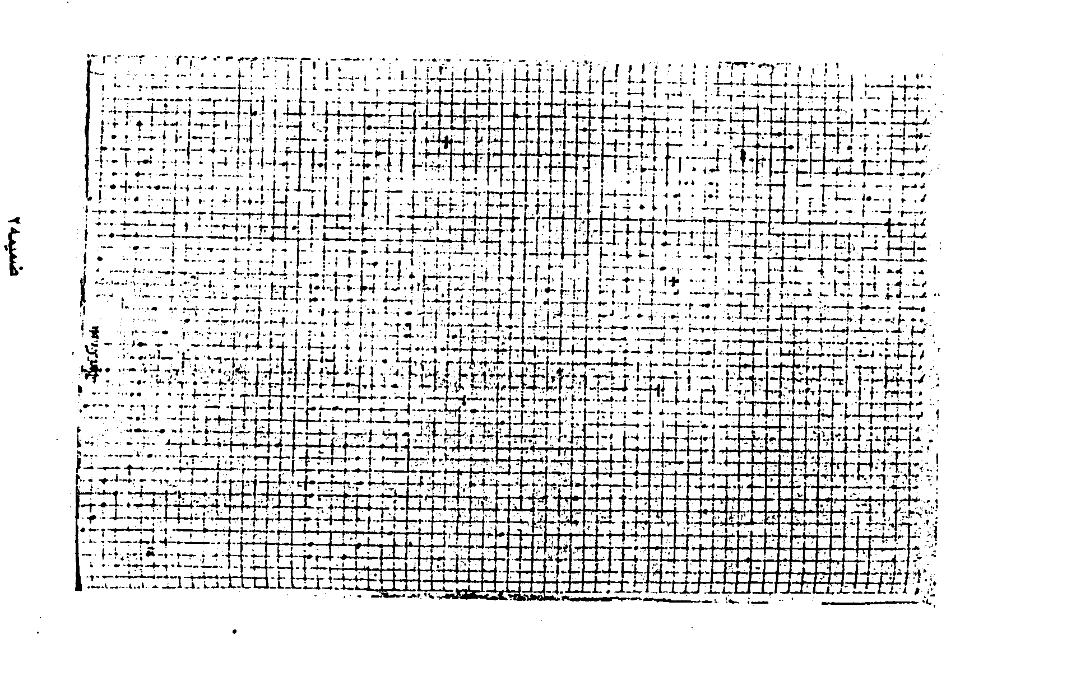

Slide 25
الف ب پ ت ج چ ح خ دذ رز ژ س ش ص ض ط ظ ع غ ف ق ك گ ل م ن و ه ي
. .
. .
.
. .
. .
.
. .
. .
.
. . .
. .
.
.

Slide 26
Hill cipher : K=mxn matrix on Z 26 such that detK is
invertible i.e.
A | B | C | D | E | F | G | H | I | J | K | L | M | N | O | P | Q | R | S | T | U | V | W | X | Y | Z
0 | 1 | 2 | 3 | 4 | 5 | 6 | 7 | 8 | 9 | 10 | 11 | 12 | 13 | 14 | 15 | 16 | 17 | 18 | 19 | 20 | 21 | 22 | 23 | 24 | 25
Note: Det must be prime w.r.t n and B det K=1 (mod n )

Slide 27
Example : If
We want to encrypt word DAVE
We have
So we have encryption
DAVE
FCFO

Slide 28
As you see If
In the real number
Now in the Z26 inverse of numbers
3 5 7 9 11 15 17 19 21 23 25 is as follow
1 9 21 15 3 19 7 23 11 5 17 25

Slide 29
RSA Cryptosystem
If A=00,B=01 ,………………………………….Z=25 dived massage to block 6.Let each
Let each block be
Receiver take the massage as

Slide 30
Example :we want to send the massage
SEND GOODS CHARGE AC CT ETC
We make the massage as block of three
0se nd0 goo ds0 cha rge ac0 ct0 etc
The massage in digit will be as
261804 130326 061414 031826 020700 170604
260200 021926 041902

Slide 31
Two points
a)How to find power?
b)How to secure more?
For breaking cipher we need two
a)Uler theorem
b)Algorithm of Uglodosean
Definition :
If
How to find factor of n?

Slide 32
We must find e,d which t satisfies

Slide 33
Example :

Slide 35
Thanks

