Slide 1
Game theory
Saeed seyed agha banihashemi
school of international relations
Of Ministry of foreign affairs
ihusaied2001@yahoo.com
www.ircrypt.com

Slide 3
Definition: Study strategic situation
Application:Economics,Army,Polotics,law,scince,biology
Grade Game
Pair
C
C
Me
Me
My grade
pair grade

Slide 4
Pair
C
Me
Income matrix
Game theory can not say what should your goal be.
If we know your goal game theory can help you.
We show possible pay off by Utility by = U
Pair
C
3
Me
0

Slide 5
Definition:we say my strategy α strictly dominate my strategy β if my pay off α is strictly
grater than β.
Lesson 1: do not play a strictly dominated strategy .
Lesson 2: Rational choice can beat to out come that suck.
Possible Pay off :
C
-1
Me
-3

Slide 6
Coordinate Game
Pair
C
α dominate β
Me
pair
C
Me
My α not dominate β

Slide 7
Lesson 4:put yourself in others shoes
Example: Joint Projeeect,price competition ,common source(oil,fish,gas)
Formal staff:Players i,j
Number of game strstegies n
Particular strategy of player I ,
:a choice for all except i
:set of possible set of strategies of player i
:Particular play of game of game
:stratagy profile pay off

Slide 8
Player 2
Example :
L
C
R
Player 1
T
5,-1
11,3
0,0
B
6,4
0,2
2,0
Players:1,2
Stratgies:
It is not dominated strategies but C dominate R
C
R
Max (3,0)=3,Max(2,0)=2
Second player must not choose R

Slide 9
Definition :Player i’s strategy
is strictly dominated if
Example :
attacker
e
h
Difender
e
1,1
1,1
h
0,2
2,0
Is weakly dominated if
For all

Slide 10
Iterative deletion of strategies
Example : model of polotics
Two candidates choose position on polotical spectrum
%10
%10
%10
%10
%10
%10
%10
%10
%10
%10
3
4
5
6
7
8
9
10
1
2
2 dominate 1
1-u(1,1)=%50<u(2,1)=%90
2-u(1,2)=%10<u(2,2)=%50
3-u(1,3)=%15<u(2,3)=%20
4-u(1,4)=%20<u(2,4)=%25
2 dominate 3
U(2,1)=%90<u(3,1)=%85

Slide 11
Definition :If we delete strategies 1 then 3 dominate
U(2,2)=%50<u(3,2)=%80
U(2,3)=%20<u(3,3)=%50
U(2,4)=%25<u(3,4)=%30
u(2,5)=%25<u(3,5)=%35
Candiate converged to center :Median Vector theorem
5,6
Player 2
Example :When we need probabilty of each event
l
r
Expected pay off of U=
U
5,1
0,2
Expected pay off of M=
Player 1
M
1,3
4,1
Expected pay off of D=
D
4,2
2,3

Slide 12
U(u,l)
5
5
4
4
3
3
2
2
1
1
U(m,l)
0
0
x
1/2
y
BR(U)
BR(D)
BR(M)
P(r)=x
D=U
X=1/3

Slide 13
Example :Penalty kick game
Persplois vs Esteghlal
l
r
L
4,-4
9,-9
U(L,l)=4
%40 chance of scoring
M
6,-6
6,-6
R
9,-9
4,-4
10
10
8
8
6
6
4
4
2
2

Slide 14
Definition :player i’s strategy
Is Best Response to the strategy
of other player if
for all
or
Solve
Definition :player i’s strategy
Is Best Response to the blief
about
the others choice if
for all

Slide 15
Partenership Game: two agent own firm jointly share % 50 of profit each.
Each agent choose effort level to put in the firm.
sinergy
Firm profit=
Pay off :

Slide 16
5
4
3
2
1
1
2
3
4
5
For b=1/4
2
7/4
6/4
5/4
1
5/4
6/4
7/4
2

Slide 17
Inefficiently low effort because at the margin
Externality

Slide 19
Nash Equilibrium:
Definition:A strongly profile
Is a NE if for each I her choice
Is a best respone to the other player’s choice
.
Motivation: No individual can do strictly better by deviating holding others fixed.

Slide 20
Example :
Player 2
l
c
r
U
Player 1
0,4
4,0
5,3
M
4,0
0,4
5,3
NE=(D,r)
D
3,5
3,5
6,6

Slide 21
Example :
Player 2
l
c
r
U
Player 1
0,2
2,3
4,3
M
11,1
3,2
0,0
NE=(M,c)
D
0,3
1,0
8,0
Relate NE to Dominace
l
r
1,1
0,0
U
D
0,0
1,1

Slide 22
Going to movies
A
B
C
A
2,1
0,0
0,-1
B
0,0
1,2
0,-1
C
-1,0
-1,0
-2,2

Slide 23
Investment game :
Players You
Strategy sets:invest 0,invest 10
If do not invest then
0
If do invest 10
5 Net profit if
90
-10
90
C
Communication can help in a coordinate game

Slide 24
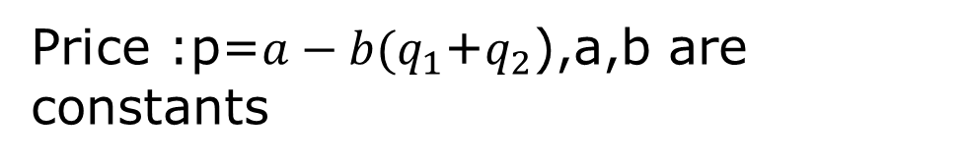
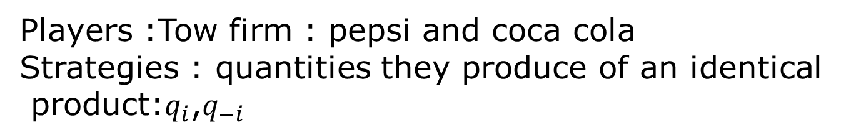
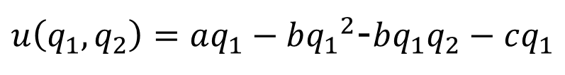
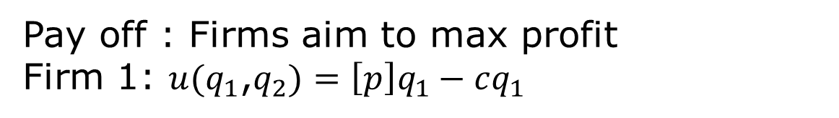
Example-6 : Cournot Duopoly Game
( strategic Substitues not strategic Coplements)
In economy we have perfect information and monopoly
among these we have Duopoly
Players :Tow firm : pepsi and coca cola
Strategies : quantities they produce of an identical
product:$q_{i}$,$q_{−i}$
C: cost of production cq c:constant marginal cost
Price :p=$a−b(q_{1}$+$q_{2}$),a,b are constants
Pay off : Firms aim to max profit
Firm 1: $u(q_{1}$,$q_{2})=\left[p\right]q_{1}−cq_{1}$
Total cost
$u\left(q_{1},q_{2}\right)=aq_{1}−b{q_{1}}^{2}$-$bq_{1}q_{2}−cq_{1}$

Slide 25


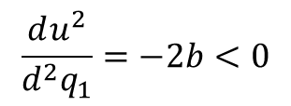

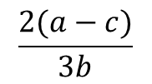
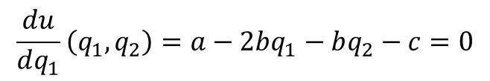

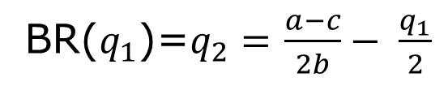




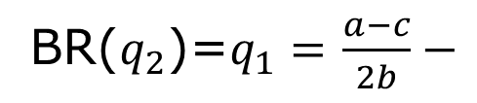


Finding Nash EQ
$$\frac{du}{dq_{1}}\left(q_{1},q_{2}\right)=a−2bq_{1}−bq_{2}−c=0$$
$$\frac{du^{2}}{d^{2}q_{1}}=−2b<0$$
F.O.D
S.O.D
BR($q_{2}$)=$q_{1}=$$\frac{a−c}{2b}−$
$$\frac{q_{2}}{2}$$
*
*
*
=$q_{2}^{}$
$$q_{1}=\frac{a−c}{2b}−\frac{q_{1}}{2}$$
$$q_{1}^{}$$
*
BR($q_{1}$)=$q_{2}=$$\frac{a−c}{2b}− \frac{q_{1}}{2}$
$${3q}_{1}=\frac{a−c}{b}$$
*
*
$$q_{1}=\frac{a−c}{3b}=q_{2}$$
Cournot quantity
*
$$\frac{a−c}{b}$$
$$\frac{a−c}{2b}$$
$$>$$
$$\frac{2(a−c)}{3b}$$
Total quanty
$$>$$

Slide 26





p
a
Slop=-b
Demand
Slop=-2b
Competition quantity=$\frac{a−c}{b}$
c
$\frac{a−c}{2b}$=
$$q^{M}$$
MR
$$\frac{a−c}{b}$$
$$q_{1}+q_{2}$$

Slide 27













$$q_{2}$$
$$q_{2}=\frac{a−c}{b}$$
BR($q_{2}$)
$$q^{M}$$
$$∗$$
$$∗$$
Nash Equlibrium
$$q_{1}=\frac{a−c}{2b}−\frac{q_{1}}{2}$$
$$\frac{q^{M}}{2}$$
$$\frac{a−c}{b}$$
BR($\frac{q^{M}}{2}$)
$$\frac{a−c}{2b}$$
$$q_{1}$$
Half Monopoly quantity

Slide 28

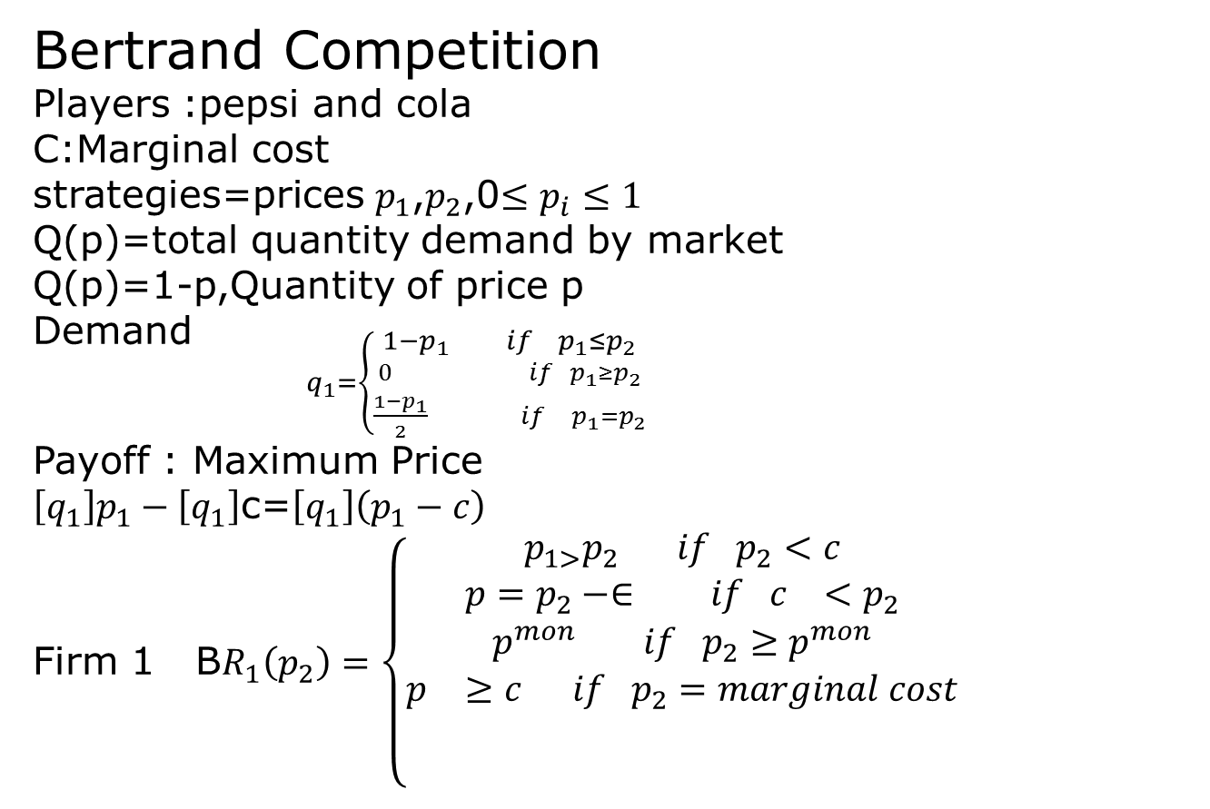
Bertrand Competition
Players :pepsi and cola
C:Marginal cost
strategies=prices $p_{1}$,$p_{2}$,0$≤p_{i}≤1$
Q(p)=total quantity demand by market
Q(p)=1-p,Quantity of price p
Demand ${}_{q_{1}=\left\{\begin{aligned}1−p_{1} if p_{1}≤p_{2} \\ 0 if p_{1}≥p_{2} \\ \frac{1−p_{1}}{2} if p_{1}=p_{2}\end{aligned}\right.}$
Payoff : Maximum Price
$\left[q_{1}\right]p_{1}−\left[q_{1}\right]$c=$\left[q_{1}\right]\left(p_{1}−c\right)$
Firm 1 B$R_{1}\left(p_{2}\right)=\left\{\begin{aligned}\begin{aligned}p_{1>}p_{2} if p_{2}<c \\ p=p_{2}−∈ if c_{}<p_{2} \\ p^{mon} if p_{2}≥p^{mon} \\ p_{}≥c if p_{2}=marginal cost\end{aligned} \\ \\ \end{aligned}\right.$
P:lowest price of two quantity
1
Nash Equilibrium $p_{1}=c,p_{2}=c$

Slide 29
Differentiated product

Slide 30
Example: security of air port
Assume two airports—A and B—and two levels of aviation security—high and low. We can think of the high level of security as allowing air travelers to have more confidence that their flight will be safe than if a low level of security were provided. In other words,the higher level of security reduces the probability of successful terrorist attempts. Table shows the hypothetical payoffs of each level of aviation security for each airport.
Airport B
High security low security
High security
800$,800$ 735$,820$
Airport A
Low security 820$,735$ 761$,761$
Nash Equblrum

Slide 31
For example, the payoffs for airports A and B when A provides low security and B provides high security are $820 for A and $735 for B.The economics underlying the payoffs in Table require some elaboration. Assume that the profits (payoffs) of each airport are $1000 prior to any security expenditures or any losses stemming from successful terrorist attacks. The expense of providing a high level of security is $200, while the expense of providing a low level of security is $50.Assume further that a successful act of terrorism imposes a cost of $1300 at the airport where the act occurs. If both airports provide a high level of security, acts of terrorism are prevented. If one airport provides a high level of security and the other provides a low level, then a successful terrorist act can occur at either airport; a successful terrorist act damaging the high-security airport would have emanated from the low-security airport. Assume the probability of a successful terrorist act is 0.1 at an airport providing a low level of security and that the probability is 0.05 that the successful terrorist act, whose roots can be traced to the airport providing a low level of security, occurs at the other airport.
These assumptions produce the payoffs in Table. In the first arrangement, assume both airports provide a high level of security; both airports
then receive a payoff of $800, which is simply $1000 less the $200 expense of providing a high level of security. There are no other cost calculations for

Slide 32
Given the preceding payoffs, what levels of security will likely be provided by the airports? Assuming that the airports make their security decisions simultaneously without communicating directly with each other, the answer is that both will provide the low level. The reasoning is straightforward. Assume airport B thinks airport A will provide the high level. If so, then if airport B also provides the high level, the payoff for airport B is $800. If airport B provides the low level, the payoff for airport B is $820. Thus, airport B will choose the low level of security because it provides the larger payoff. What happens if airport B thinks airport A will provide the low level of security? Once again, airport B will choose to provide the low level of security because the payoff to airport B is larger with the low level of security (that is, $735 versus $761). Thus, regardless of what airport A
chooses, airport B will choose the low level of security. By the same reasoning process, airport A will choose the low level of security regardless of airport B’s choice. The so-called dominant strategy is for both airports
to choose the low level of security. Note that the payoff for both airports is $761 and that such a payoff is inferior to the payoff of $800 to both airports
if they had both chosen to provide the high level of security. Thus, when the airports choose their security level simultaneously without coordinating
their decisions, there is a high probability that they will end up with lower security throughout the network. In addition, the airports will achieve
lower payoffs than if they had coordinated their security decisions and jointly provided a high level of security.

Slide 33
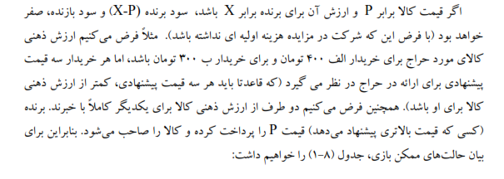
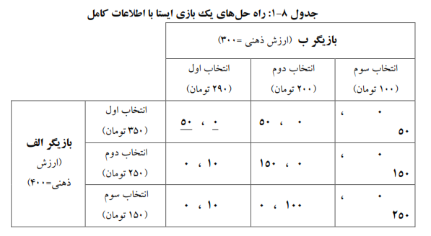
1-5
5-1
1-5

Slide 34
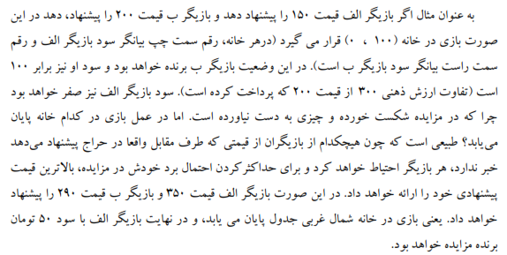

Slide 35
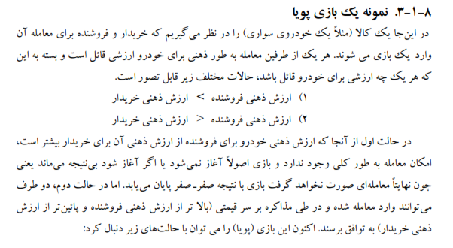

Slide 36
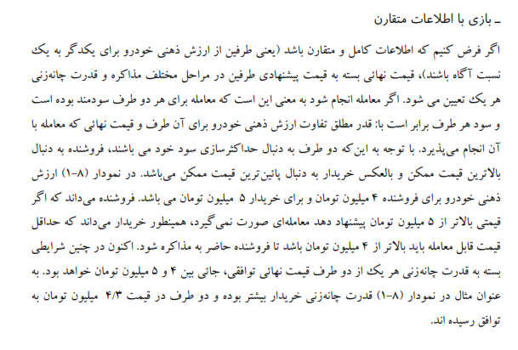

Slide 37
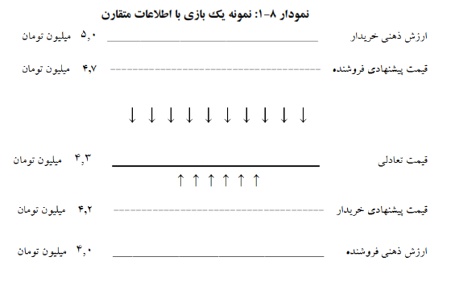
2-5
2-5

Slide 38
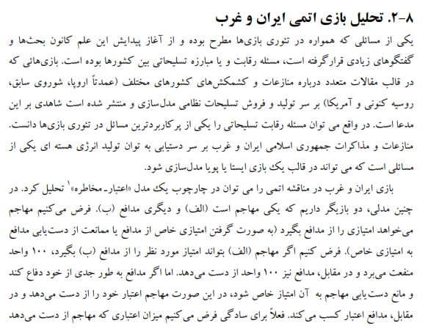

Slide 39
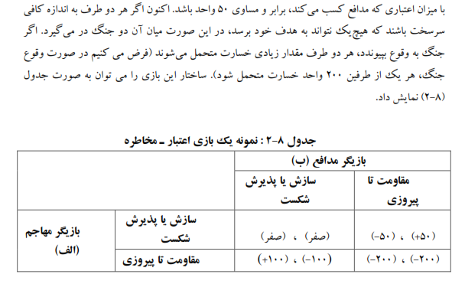
3-5
3-5
3-5
3-5
3-5
3-5

Slide 40
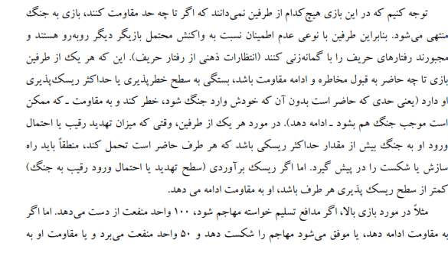

Slide 41
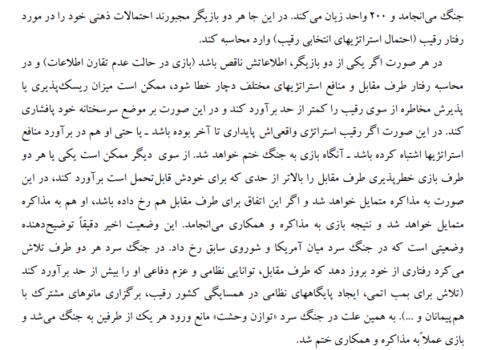

Slide 42
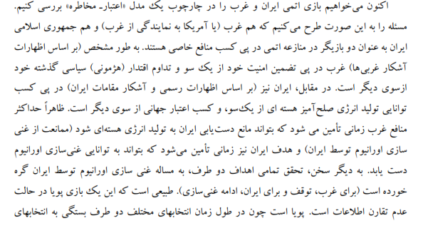

Slide 43
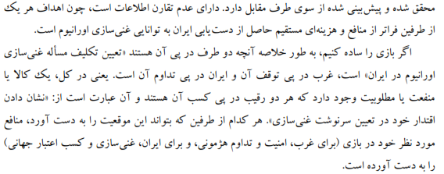

Slide 44
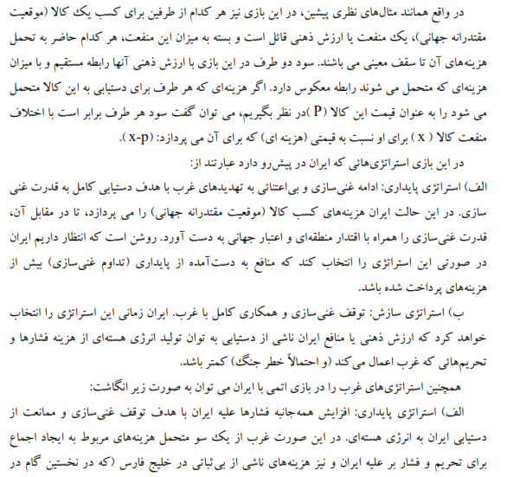

Slide 45
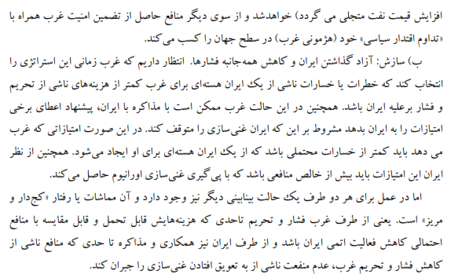

Slide 46
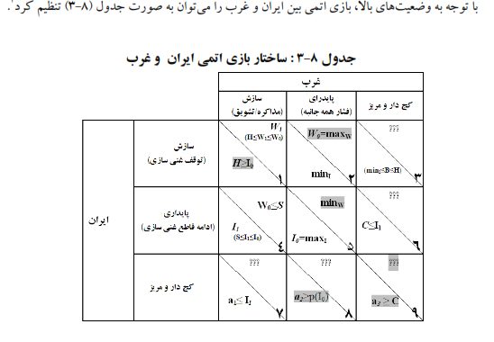
ذیل
4-5

Slide 47
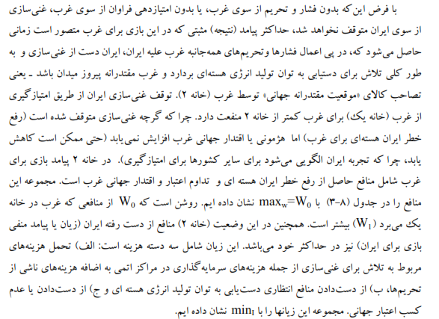
3-5

Slide 48
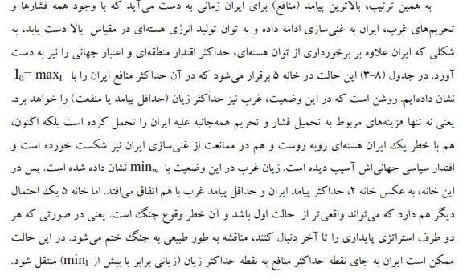
3-5

Slide 49
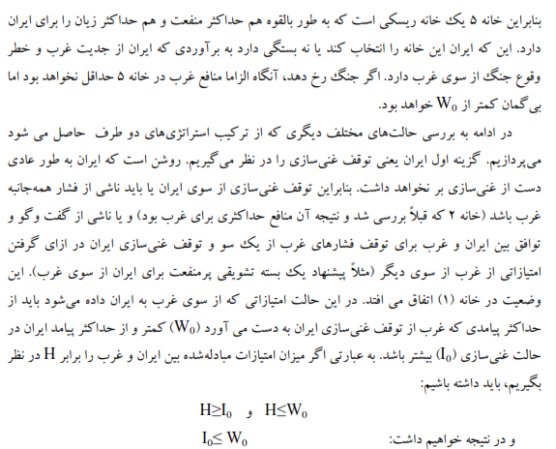

Slide 50
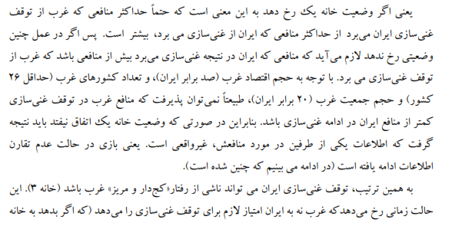

Slide 51
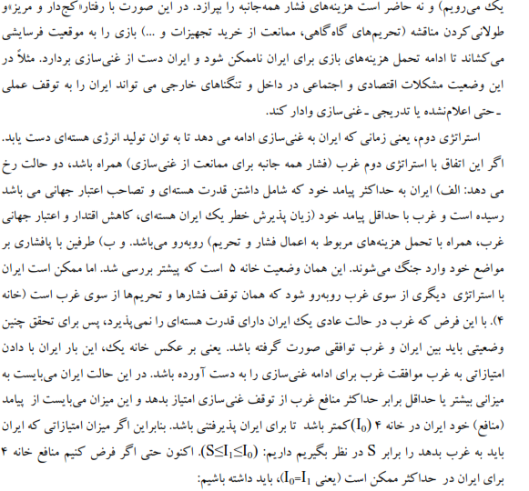

Slide 52
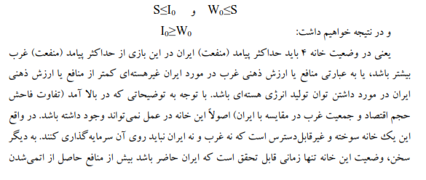
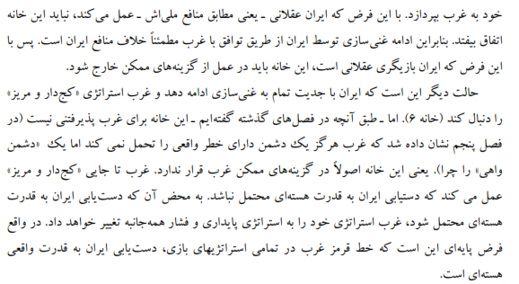

Slide 53
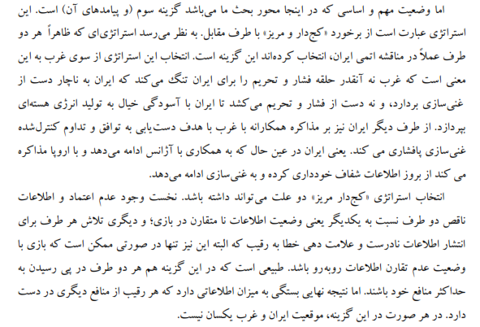

Slide 54
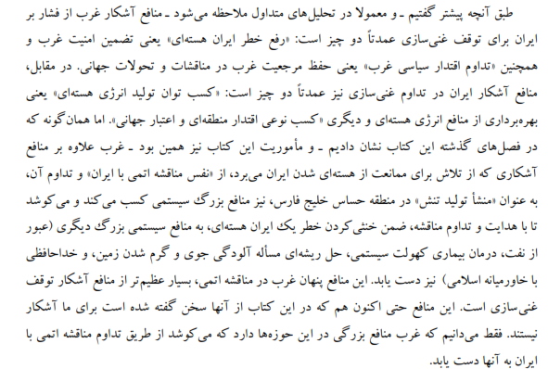

Slide 55
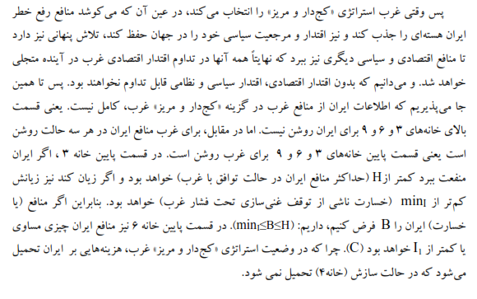

Slide 56
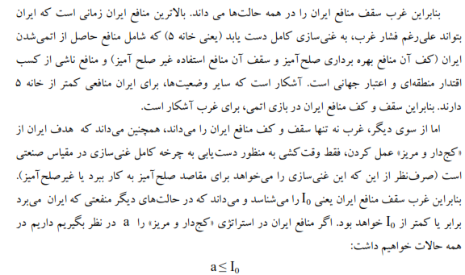

Slide 57
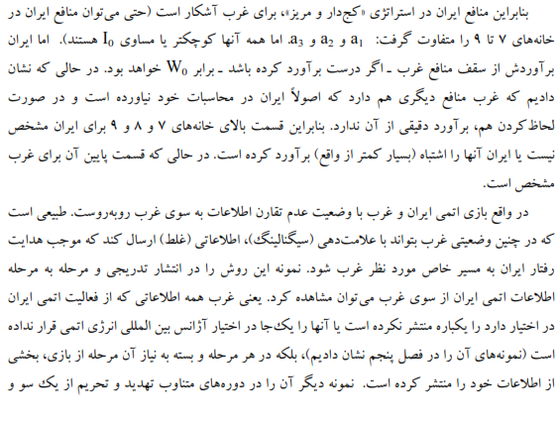

Slide 58
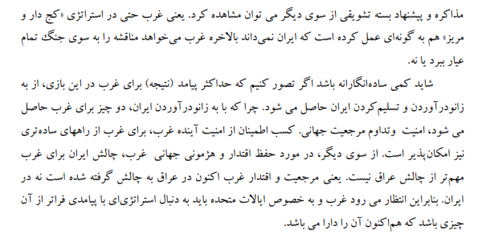

Slide 59
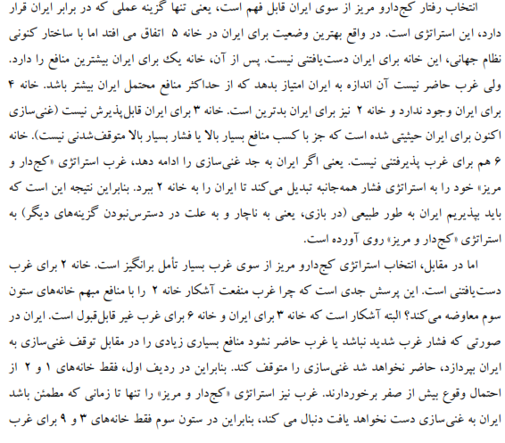

Slide 60
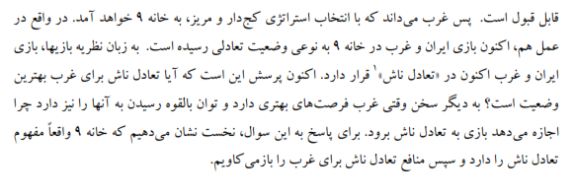

Slide 61
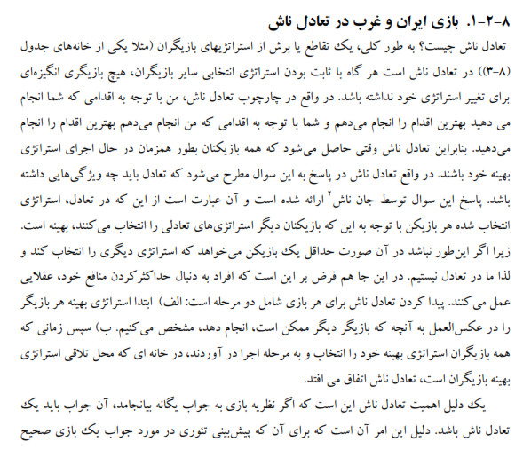

Slide 62
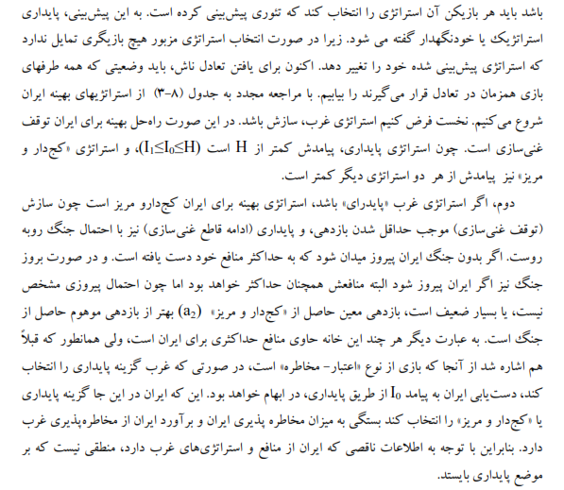

Slide 63
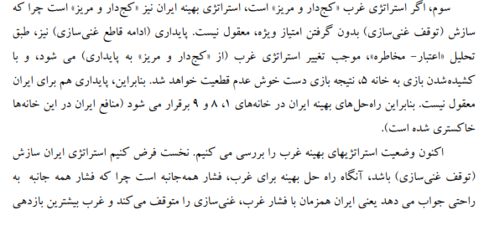
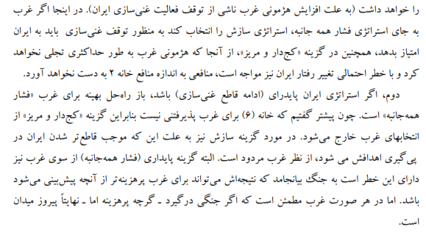

Slide 64
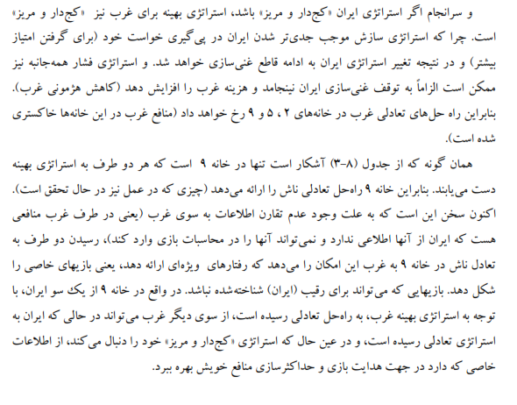
3-5

Slide 65
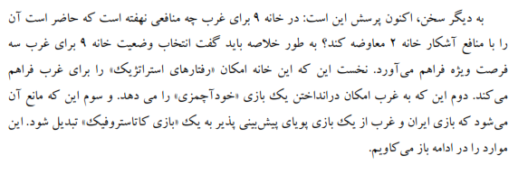

Slide 66
Conflict of Iran and USA
IRAN
A
R
A
b,b-c
0,b
USA
b-p,-c-d
-p,-d
P
-c-d:IRAN negotiaes and USA punish IRAN
Iran acquiesce (A) b>b-c>-d>-c-d
Iran rebel (R)
b:both nation acquiescs
USA : acquiesce (A) b>b-p>0>-p
USA : Punish (P)
0: IRAN rebels and USA acquiesces
-p:USA punish IRAN
b-c : remainig in the alliance
-q : Iran refuse USA offer
In this game both USA and IRAN have dominat strategies

Slide 67
IRAN
A
R
USA
USA
b,0
-d,-p
b-c,b
-c-d,b-p

Slide 68
The typical manner in which incomplete information is treated
In extensive form games is through the introduction of nature .
Nature is portrayed as moving first and id unobserved by at least
one of the players .Nature serves to determine a player’s type,
which includes stratedy set ,information partition ,and pay off
function.
Differential products linear city model
First set
Each consumer choose products whose total cost to her is
smaller
For example at y if buys from firm 1 pay
For example at y if buys from firm 2 pay
Firm 1
Firm 2
y

Slide 69
Candidate –Voter Model
0
1
Even distribution of voters
Voters vote for the closest candidates
1-The number of candidate is not fixed
2- Candidate can not choose their position each voter is potential candidate
Players: voters /candidates
Strategy: to run or not to run
Voters vote for closest running candidate
Win if plurality
Prize of win =B≥2C
Cost of running =C
And if you at x and winer at y
Pay off
Pay off Mr x:
Example:(i) if Mr x enter and win
B-C
(ii)If Mr x enter but may wins
(iii)If Mr x stay s out Mr y wins

Slide 70
Voter - candidate Model
Players: voter /candiates
Strategies: run or not run win : most vote pay off:
No fix candidate.
Lesseon 1-May NE not all at center
2- Entry can lead to more distant candidate winning .
3- if two far a part someone will jump into the center
How far a part can two equiblrium candidates be .
Winner Price B B≥2C
Cost of running C
And if you are inposition
X any winner candidate on
Y your cost –(x-y)
0
1
1/6
2/6
1/2
4/6
5/6
L
M
R
4- if the candidates are too extreme in center will enter
5- guesses an check

Slide 71
Pay off of X
1) If x enter and win
B-C
2) If x enter and y win
-C-(x-y)
3) X out and y win
-(x-y)

Slide 72
Location Model:
Strategies: Two town E and W
Players: Two types of people T and S
Pay off
of you
1
1/2
1/2
0
No of people of your type in your town
50
100
Rules:
Simultaneous choice if there is no room ,then randomize to
Ration
Outcome :segretion
Equal :2 segregated equilibra

Slide 73
NE : Two segregated NE tall in west short in east vice versa ( stable )
Integrated NE : ½ of each in each town ( not stable weak equilibrate)
Tipping point
-all choose same two and get randomized .
Lesson :seemingly irrelevant details can matter.
Having society randomize for you ended up better then active choice
Lesson :
1-sociology seeing segregation
Preference for segregation
2-policy randomization busing
3-induvidual randomization NE.
Example : Rock ,paper ,sassier
No NE
Strategi es:R,P,S
R
S
P
R
Claim : each player chooses (1/3,1/3,1/3) is BR
0,0
1,-1
-1,1
Expected pay off (1/3,1/3,1/3)
S
-1,1
0,0
1,-1
EP(R)=1/3[0]+1/3[1]+1/3[-1]=0
EP(S)=1/3[-1]+1/3[0]+1/3[1]=0
EP(P)=1/3[1]+1/3[-1]+1/3[0]=0
P
1,-1
-1,1
0,0
Claim : each player chooses (1/3,1/3,1/3) is NE .

Slide 74
Definition:
A mixed strstargy
Is randomization over i’s pure strategies .
Is the probability that
assigns to pure strategy
.
Could be zero (1/2,1/2,0 )
Could be one
Pure strategy
Pay off from mixed strategy
The expected pay off the mixed strongly
Is the weighted average of the
Expected pay off of each of the pure strategies in the mix.

Slide 75
Example :
a
b
A
1
2,1
0,0
1/5
B
0,0
1,2
4/5
1/2
1/2
Supose : p=(1/5,4/5)
q=(1/2,1/2)
What is p’s expected pay off ?
1)EU (A,q)[2](1/2)+[0](1/2)=1
EU(B,q)=[0]91/2)+[1](1/2)=1/2
2)EU(p,q)=(1/5)EU(A,q)+(1/3)EU(B,q)
=(1/5)(1)+(4/5)(1/2)=3/5

Slide 76
Lesson:
If a mixed strategy is BR then each of the pure strategies in the mix must
be a BR.
In particular each must yield the same expected pay off .
Definition :
A mixed strategy profile
Is a mixed strategy
NE if for each player i
Is a BR to
Lesson:
If
then
Is also a BR to

Slide 77
Example :The Welfare Game
beggar
Government
G/B
working
begging
x
support
3,2
-1,3
1-x
unsupport
-1,1
0,0
y
1-y
Example : Tennis game
E
A: ali Vs E: Ehsan
l
r
Passing
Shot
L
50,50
80,20
A
R
90,10
20,80
There is no pure strategy NE.Let’s find a mixed strategy NE.Trick : to find ehsan’s NE mix
(q,1-q) look at Ali’s pay off [50]q+[80](1-q)
R
[90]q+[20](1-q)

Slide 78
If ali is mixing in NE then the pay off to L and R must be equal
50q+8(1-q)=90q+20(1-q)
60(1-q)=40q
60=100q
q=0.6 Ehsan is Mix
To find ali Nemix use Ehsan pay off s (p,1-p)
l [50]p+[10](1-p)
r [20]p+[30](1-p)
30p=70(1-p) 100p=70
P=0.7 Ali’s mix
NE=[(0.7,0.3),(0.6,0.4)
L R l r
Ehsan
l
r
L
Ali
30,70
80,20
p
R
90,10
20,80
1-p
q
1-q
q
i ) strategic effects E should lean l more
ii) Strategic effect: Ali hits L less often often so E use ali pay off
q

Slide 79
Ali L
[30]q+[80](1-q)
60q=60(1-q)
q=0.5 q went
R
[90]q+[20](1-q)
Direct effect
Strategic effect is bigger
q
Strategic effect
70p+10(1-p)
20p+80(1-p)
50p=70(1-p)
E: l
P=7/12<7/10=0.7
Comparative statics
Bringing each offer back into equilibrium
l
r
L
50,50
80,20
Ali
R
90,10
20,80

Slide 80
Check
Is a
Ali’s pay off
=0.7
L
50(0.6)+80(0.4)
0.62
=0.6
R
90(0.6)+80(0.4)
0.62
Ali’s pay off
From
(0.7)(0.62)+(0.3)(0.62)=0.62
We can see that ali has no strictly profitable pure strategy deivation .
This implies there is no strictly profitable mixed strategy deviation either.
Lesson :
We only ever heve to check for strictly profitable pure strategy deviation

Slide 81
Battle of couple
D
Ap
Rep
Ap
p
2,1
0,0
N
Rep
0,0
1,2
1-p
q
1-q
Pure strategy NE (AP,AP) ,(Rep,Rep).Find a mixed NE of this game :
To find NE q using N pay off
Ap 2q +0(1-q)
Rep 0q +1(1-q)
N
2q =1(1-q) (1-q)=2/3 q=1/3
To find NE p , use D pay offs
D AP 1p+0(1-p)
Rep 0p+2(1-p)
1p=2(1-p)
(1-p)=1/3 p=2/3

Slide 82
Check that p=1/3 is BR for N
N
AP 2(1/3)+0(2/3)
Rep 0(1/3)+1(2/3)
= 2/3
p
2/3[2/3]+1/3[2/3]=2/3
No strictly profitable pure deviation
No stictly profitable mixed deviation either
N
D
NE =[(2/3,1/3) ,(1/3,2/3)]
[2/3,2/3]
Pay off are low because they fail to meet sometimes
Prob(meet) =

Slide 83
Interpretations of mixing probabilities :
1)People literally randomization
2)Belifs of others actions (that make your indifferent between things you have do.
Tax payer Game
H
C
A
2,0
4,-10
p
N
4,0
0,4
1-p
q
1-q
No pure NE
Find mixed NE
AUD
A 2q+4(1-q)
N
4q+0(1-q)
2q=4(1-q)
q=2/3
TAX H
0
4=14p
P=2/7
C
10p+4(1-p)

Slide 84
In equilibrium which will audited more (but will cheat with same [equilibrium ]rate .
To get higher compliance rate :change pay off to auditor
–make it less costly to do on audit
-give a bigger gain for catching a cheater
Or set audit rates higher ,by congress
But congress man are wealthy and may have a conflict of interest .
Lesson 1:can inter pert proportion of people playing
Lesson 2: check only for pure derivation
Evolution and Game theory:
1)Influnce of Game theory on bio animal behavior
Stratgies gens
Pay off genetic fitness
Good strategies grow but the strategies are not chosen
2)Influence from bio
Social science
Firms with rules of thumb decision and markets selecting /surviving the fittest.

Slide 85
Species competition
/Symmetric 2 player game
/Large population random matching
Example : Lions on a hunt ants detending a nest
C
D
C
2,2
0,3
Is cooperation is evolutionary stable?
D
3,0
1,1
C rs
D rs
So calculate C is not ES (Evolution stable)
C
D
Is D ES?
D rs
C
2,2
0,3
D
3,0
1,1
√
C rs

Slide 86
Lesseon 1:Nature can suck (Sexual reproduction can change this )
Lesson 2:If a strategy is strictly dominated then it is not ES
Strictly dominated strategy.
a
b
c
a
2,2
0,0
0,0
b
0,0
0,0
1,1
c
0,0
1,1
0,0
Is c ES?
c vs
^
b vs

Slide 87
b will grow from small proportion to ½
Note b the invader is itself not ES but it still avoids dying out
Is c a NE?
No because b is a profitable deviation
Lesson : If (s,s) is not NE.
Then s is not ES If s is ES (s,s) is NE
a
b
a
1,1
0,0
0,0
0,0
b
NE =(a,a) ,(b,b)
b
0
^
a
So b , b was NE but was not ES
Reason is because b is a weak NE.
If (s,s) is strict NE then s is ES

Slide 88
Definition :
In a symmetric 2 player game the pure strategy is ES (in pure strategy ) if there exist
On
It is true for all possible deviation and for all mutation size .
Pay off ES > pay off to mutant for all small mutations.
Definition
In a symmetric 2 player game a strategy is ES ( in pure strategy)
If (i) is a (symmetric ) NE i.e for all and
If (ii) then for all .
In better beat up on the mutant .
Fix and suppose is NE (i.e for all
Two cases : a)
For all
The mutant dies but because she meet s
b)
but
The mutant does o.k against but badly
against .

Slide 89
Is this game ES?
a
b
a
1,1
1,1
b
1,1
0,0
(a,a ) is symmetric NE
Is (a,a) strict NE? NO
U(a,a)=U(b,a) =1
U(a,b)>U(b,b) so a is ES
1 0
Evolution of social Convention :
Driving on L or R
(L,L)
(R,R)
NE
L
R
L
2,2
0,0
0,0
1,1
R,L are ES
R

Slide 90
Lesson : We can have multiple ES
Convention:
This need not to equally good
Example:
a
b
There is not symmetric pure
strategy NE In the game
a
0,0
2,1
Aggressive
Non aggressive
1,2
0,0
There is symmetric mixed
NE strategy In the game
b
[(2/3,1/3),(2/3,1/3)] is NE
Monomorphic
One type
Polymorphic
Stable mixed type
In a 2 player symmetric game
Strategy is ES (in mixed strategies )
a) If
Is a symmetric NE
b)
If
Is not strict NE

Slide 91
In a symmetric 2 player game a strategy is ES ( in mix strategy)
If (i) is a (symmetric ) NE
and
If (ii) it is not strict NE i.e if there is an
Then ………………………………………………………………………….

Slide 92
If there is an
with
Can not be strict scince it is mixed NE .
Need to check
For all possible mixed mutation
Huck and Dove is D ESS?
Can we leave ES population of Dove
Prize =v>0
Cost of fight =c >0
H
D
H
v,d
D
0,v
v/2,v/2

Slide 93
Is (D,D) is NE ? So not ESS
Is H ESS?
(H,H)is NE ? Yes if
Case 1) v>c
(H,H) is strict NE.
2)
U(H,H)=u(D,H) check u(H,D)>u(D,D)
v
v/2
We should if
Then H is ESS.
If c>v we know H is not ESS
If c>v we know D is not ESS
What about mix
1) Find symmetric

Slide 94
Therfore
Is a mixed NE.
It is not strict NE.
To check
For all possible .
Lesson : If v<c then ES mix then v/c Hucks .
a)As v increase see more Hucks
As C increase see more Doves
b) Pay off :
When c increase pay off increase
c) Identification : WE can tell what (v/c) is from looking to data.

Slide 95
The only ESS (1/3,1/3,1/3)
1<v<2
S
K
G
S
1,1
V,0
0,v
1/3
V=win
0= lose
1=tie
0,v
1,1
V,0
1/3
K
V,0
0,v
1,1
1/3
G
1/3
1/3
1/3
Is this ES ?
ESS
Since v<2
U(s,s)=1
Example there is no ECS

Slide 96
Cash in hat
Player 1 can put 0 $,1$,3$ in a hat is passed to player 2.
Player 2 Can either match i.e add the same amount or take the cash.
Pay off player 1
0
0
1
Duble if match
-1
If not match
3
If match
-3
If not match
Player 2
Not 1.5 if match 1
Not 3 if match 3
The $ in the hat if

Slide 97
Sequential move game
Player 2 know player 1 choice before 2 choose .
Player 1 Know that this will be the case
1
3
0
1
Backward induction
2
(0,0)
-3
2
+3
-1
+1
(-3,3)
(3,2)
(-1,1)
(1,1.5)
Moral hazard
Agent has incentive to do things that are bad for principal.

Slide 98
1
3
0
1
2
(0,0)
-3
2
+3
-1
+1
(-3,3)
(3,2)
(-1,1)
(1,1.5)
P-house
P-house

Slide 99
Example : kept the size of loan / project small to reduce the temptation to cheat.
Solution : Low – limits /restrictions on money – break loan up – change contract to give
incentives not share
Intensive design:
A smaller share of a large pie can be bigger then a large share of a small pie
Incentive contracts CEOS
Baseball Mangers
Price rate
Share cropping
incentives
Collateral :subtract house from
Runaway pay off s:
< Lowers pay off to bonoaer at same tree points ,yet makes the borrower better of
Lowers your pay off ( if you do not repay)
Better off
Change the choice of others in a way that helps you.

Slide 100
N
burn
Not burn
sax
RA
F
sax
(1,2)
u
N
F
RA
F
N
RA
F
(0,0)
(0,0)
(2,1)
(1,2)
N
(N,Sax)
F
(2,1)
Getting rid of choice can make better off .
Commitment options .
Changes behavior of others .
The other players must know.

Slide 101
Quantity Copmetition
Demand curve
Revisited -Stackelberg
p
a
Conut:
Slope -b
q
2
BR
1
NE
BR
2
q
1
Monopole quantity

Slide 102
Use backward induction :
Firm 2 sees
and must choose
By definition
Tells us the profit –maxmize out put of firm 2 taking
as given.

Slide 103
Strategic substitutes :
This suggest firm 1 should set
To induce
This suggest to induce
Firm’s 1’s porfits
Consumer surplus
To firm 2 profit
cs
Price
cost
B.I solve for firm 2 first taking
as given max
revenue
<< differentiate w.r.t
Set to,0
solved

Slide 104
Now solve for firm 1
First order conditions
Second order condition o.k

Slide 105
Check
1)Commitment : sunk costs can help
2)Spy or having more information can hurt you.
Key : the other players know you had more information <for it to hurt you ‘
Reason :it can lead action that hurt
3- first move advantage

Slide 106
Zeimelo Theorem
2 player perfect information
Infinite nodes three or two out come
Either 1 can force a win (for 1)
Or 1 can force a tie
Or 2can force a lose
Example nun unequal
1 Can force a
w
1
Equal
2 can force
Example : chess
Proff: (by induction ) on maximum length of game N.

Slide 107
If N=1
w
T
N
w
1
L
T
Suppose the chain is true for all games of length
<N
We will claim therefore it will be true for games of length
N.
T
T
L
L
L
L
L
L
L

Slide 108
w
1
This is sub game
Following 1 choosing
dwon and it has length 2
up
w
This is a sub game
following up and it
has length 3
1
2
Down
1
1
2
1
2
1
L
1
Example N=3
N+1 =4
Induction hypothesis by induction hypothesis upper
Subgame has a solution say w
1

Slide 109
By induction hypothesis ,lower sub game has a solution say L
1
So translate the above game to
w
up
1
w
This has a solution ,it is a game
Of length 1
1
Down
L
1
Perfect Information
Definition : A game of perfect information is one in which at each node the player whose
turn it is to move knows which node she is at ( and how she got there )
Definition : a pure strategy for player i in a game of perfect information is a complete plan
Of action if it specifies which action i will take at each of i’s decision nodes.

Slide 110
Example:
1
D
U
2
l
r
1
(1,0)
d
u
(0,2)
(3,1)
(2,4)
Player 2 strategies [l][r]
Player 1 [U,u],[U,d],[D,u],[D,d]
BI([D,d],r)
l
r
2,4
0,2
NE = ([D,d],r),[D,u],r)
3,1
0,2
1,0
1,0
1,0
1,0

Slide 111
Enternt
Incombat=IC
out
IN
Ic
(0,3)
NF
F
(1,1)
(-1,0)
Ic
F
NF
IN
-1,0
1,1
Ent
out
0,3
0,3
NE(IN,NF)
BI
(out,F)
What is happening with this equlib?
It is a NE but realize on beliving on incredible threat.
Chain store paradox

Slide 112
Duel -when: Shooting ,cycling ,product Launch
Let
be player i,s probablity of hitting if i shoots at distance d:
1
d
0
Assume :abilities known
PREEMPTION
FACT A:Assuming on –one has thrown if i knows (at d) that j will not shoot tomorrow
At d-1 then i should not shot today.

Slide 113
Fact B: Assuming no –one has thrown if i knows (at d) that j will shoot tomorrow
(at d-1),then i should if i’s prob of hitting at d
j’s prob of missing d-1
*
1
shoot
s
s
s
s
N
N
N
N
N
N
N
N
N
N
N
N
N
*
d
Claim :The first shot should occour at

Slide 114
Number one should shoot before
By dominance but at
there is no dominance
need BI you need to know what you belive about their next move .
At d=0 (say 2’ s turn )shoot
At d=1 (say 1’s turn).
I know that 2 will shoot tomorrow by B should shoot if
At d=2 2’s
2 should shoot if
Who shoots first not necessarily better or worse shoter but whoever’s turn it is first at
(where
Is determined by their joint ability ).
You can solve hard problems with dominance and BI.
If playing an un –sophisticated player –still do not show before
People shoot early
Over confidence
-pro –active bias
Sometimes watting is a good strategy

Slide 115
Ultimatums & Bargaining
2 player 1 &2 $ 1
1 can make a take it or leave offer to 2 (s ,1-s)
2 can accept
(s,1-s)
Or 2 can reject
(0,0)
BI
(99 c ,1c ) or(100,0)
2.Period Bargaining : $1
Stage 1: Player 1 makes offer to 2
If 2 rejects

Slide 116
Stage 2 ; 2 gets to make offer to (
1 Can accept
If rejects
(0,0)
Disconting $ &
offer
reciver
1 | 0
Three stage
Four stage
0 stage
One stage
Two stage

Slide 117
If player 1 offer 2 >
2 will accept
If player 1 offer 2 <
2 reject
1
Two stage
Three stage
Stage one
1
3 stage
1- 1makes offer if accepted done
2- 2 makes offer if accepted and done
3- 1 make offer if accepted

Slide 118
Geometric series :
1
Not an exponent
Power exponent
Just a superscript
0
0

Slide 119
Suppose rapid offer so
S=1/2
1-s=1/2
Conclude Alternating offer bargaining
1- even split if potentially can bargain for ever ,no discounting or rapid offer
Some discount factor
2- The first offer is expected (no hagging in equilibrum )
Volume of the pie and value of time
when assumed known
Example :
1
U
D
2
M
2
r
l
d
u
(0,0)
(1,2)
2
(0,4)
(4,0)
(4,0)
(0,4)

Slide 120
1
D
U
2
u
r
2
d
l
M
(4,0)
(0,4)
(0,0)
(1,2)
d
2
u
(4,0)
(0,4)
Information
Set player 2 can
Not distingish
Here I might randomize between U and M .

Slide 121
Formal Definition
An informal information of player is a collection of player I’s nods
among which I can not distinguish rules not allowed
1
1
2
2
2
2
1
1
Perfect recall

Slide 122
Definition :
Perfect information :all information sets in the tree here just one node
Imperfect information : not perfect information
Example:
1
D
U
r
l
(-1,3)
(2,2)
(0,0)
(3,-1)
Definition: A pure strategy of player i is a complete plan of action
It specifies what player i will do at of it if set .
l
r
U
2,2
-1,3
PD Game
D
3,-1
0,0

Slide 123
Example :
1
D
U
2
l
r
r
m
m
l
2
1
D
D
U
D
U
U
2
l
m
r
U
1
D
What matter is information not time

Slide 124
1
D
U
r
l
2
(4,2)
r
l
u
d
(2,4)
(0,0)
(0,0)
Subgame
(1,4)
Strategies for 1:
Strategies for 2: l,r
l
r
4,2
0,0
NE:
Not BI
4,2
1,4
0,0
2,4
0,0
2,4
SPE

Slide 125
Example :
1
A
B
1,0,0
2
U
D
l
r
0,1,1
3
0,0,2
r
l
2,1,0
0,0,-1
Subg-ame
A
B
l
r
l
r
U
1,0,0
1,0,0
U
0,1,1
0,0,2
D
1,0,0
1,0,0
D
0,0,-1
2,1,0
SPE:
(B,D,r)
(D,r)
Lets of NE: eg [A,u,l] look at the subgame

Slide 126
3
r
NE of the subg-ame (D,r)
l
U
1,1
0,2
2
D
0,1
1,0
Definition: A subg-ame is a part of game that looks like a game with in the tree it satisfies
i)It starts from a single node
ii) It comprises all successors to that node
iii) It does not break up any informations sets.
Definition: A NE
Is a sub game perfect equilibrium (SPE)
If it includes a NE in every sub-game of the game .
2
1
1
1
2
1

Slide 127
Example : Do not screw up
1
U
D
2
l
2,1
r
1
1,2
d
3,1
u
1
2
3
4,3
NE
:
BI
BI
BI
2
l
r
4,3
1,2
3,1
1,2
1
2,1
2,1
2,1
2,1

Slide 128
Which sub-game are SPE NE? To find SPE
1
d
u
u
4,3
NE=u
d
3,1
4,3
3,1
1
2
3
The only SPE ( u,l) which is BI
u
u
d
3 is eliminated because it induces play in this sub-game that is not NE
4,3
Pure NE [u,l],[d,r]
1
u
2
l
r
l
d
2
u
4,3
1,2
3,1
1
2
3
r
1
d
3,1
1,2
1,2
[u,l]
[u,r]
[d,r]

Slide 129
Matchmaking Game
Player 1: match maker player 1.2
0,0,0
1,2,1
Not SEND
G
1
S
G
SEND
-1,0,0
2
3
-1,0,0
S
G
S
1,1,2

Slide 130
There is also mixed strategy
G
S
G
1,2,1
-1,0,0
2/3
2
S
-1,0,0
1,1,2
1/3
1/3
2/3
Pure NE (G,G),(S,S)
And value 1 for 1
0,0,0
NOT SEND
SPE=(SEND,S,S),(SEND,G,G)
1
=1
SEND
(value to 1 of NE in this sub game)

Slide 131
SPE=(send,S,S),(send ,G,G)
In this dub game there is a mixed NE [(2/3,1/3),(1/3,2/3)]
If 1 send 2 and 3 then they meet with prob 2/9+2/9=4/9 andd hence fail to meet with
prob =5/9
The value of 1 of this NE is 4/9[1]+5/9[-1]=-1/9
0
NOT
1
SPE=(NOT,Mix,Mix)
SEND
-1/9=(NE)

Slide 132
Example : Strategic invesment
2 firm Counot competition
Demand curve
MC C=1$ a ton
Counot quantity
(1 milion ton of fertilizer)
New machine :
Only work for A
0.7 million per year
It lower A’s cost 50 C a ton
To rent or not rent?
Accountants Answer:
Produce 1M tons per
year save 50c per ton
Save 0.5 M a year in variable cost

Slide 133
Cost of machine : fixed cost of 0.7 M
0.5<0.7
So not to rent
P,c
Residual MR (marginal revenue)
Residual demand curve
1
Area of triangle =3/16
C
Missed triangle has area
3/16 =0.19
q
A
1M
0.5+0.19=0.69<0.7
So not rent
Accounting answer
Area =0.5
1

Slide 134
Game theory answer
q
A
q
B
q
B
Old BR
A
We get extra 0.31+0.69
=1 >0.7
New BR
A
Strategic effect
BR
B
q
A
We could calculate the new NE
Sub game is BR diagram above

Slide 135
Lesson : strategic efforts matter I
-invesment game
-tax desgin
-tolls
2 player : each period each choose F(fight) or Q (quits) games ends as soon as some one Q,s
Good news : if other players quits first win a prize .
Bad news : each period in which both F each player pay cost: –c=0.75 if both
Quit at once
0
Example :WWI BSB v.s sky WARS of attrition
A
B
F(1)
Q(1)
A
f(1)
q(1)
F(2)
q(1)
f(1)
Sunk cost
Q(2)
V,0
f(2)
0,v
0,0
q(2)
f(2)
-c-c,-c-c
q(2)
-c+v,-c+0
-c+0,-c+v
-c+0,-c+0
Two case:v>c here in clases v<c on home work

Slide 136
Second sub game
f(2)
q(2)
F(2)
 | 0.0
-c,-c
v,0
-c
Sunk cost
Q(2)
0,v
Two pure strategy NE in this sub game : (F(2),q(2)) ,(Q(2),f(2))
Pay off (v,0) ,(0,v)
First stage revisited
A
Q(1)
F(1)
B
q(1)
f(1)
q(1)
f(1)
-c +2stage NE pay off ,
-c+ 2 stage NE pay off
0,0
0,v
V,0
Continuation pay off

Slide 137
B
Case1:For (F(2),q(2)) in stage 2
f(1)
q(1)
F(1)
A
Q(1)
-c+v,-c+0 | v,0
0,v | 0,0
NE (F(1),q(1))
V>C
B
f(1)
q(1)
F(1)
 | V,0
0,v | 0,0
-c+0,-c+v
A
Case 2:For (Q(2),f(2)) in stage 2
Q(1)
NE (Q(1),f(1))
Pure strategy SPE v>c
[(F(1),F(2)),(q(1),q(2))]
[Q(1),Q(2)),(f(1),f(2)]
B
f(2)
q(2)
F(2)
 | 0,0
-c,-c
v,0
A
Q(2)
0,v
p
1-p
If A fights
-cp+v(1-p)
=
0p+0(1-p)
V(1-p)=pc
P=v/v+c
1-p=c/v+c
If A quits
Mixed NE has both fight with prob =v/v+c
Pay off in this mixes NE=(0,0)

Slide 138
A
Stage 2 NE pay off
Q(1)
F(1)
f(1)
q(1)
V,0
-c
+
0,0
0,v
B
f(1)
q(1)
-c +0,
-c+0
V,0
F(1)
A
Mixed NE of period two
Q(1)
0,v
0,0
p
1-p
Mixed SPE in this matrix is both F with prob
Mixed SPE pay off is 0
Prop of fighting occurring v c

Slide 139
Infinite period Game
………..
stage4532
Sunk cost
…………………….
-c+ Continuation value
-c+ countinuation value
…………………
V,0
P
0,v
If mix in future
Count vale is (0,0)
0,0
T

Slide 140
Repeated Interaction :Cooperation
Lesson : In on going relationships the promise of future rewards and the threat
Of future punishments may sometimes provide incentives for good behavior today .
But for this to work it helps to have a future
Lame duck
Retirement end pay off
Economics major relationships
B
coop
defect
A
B
B
A
B
A
coop
2,2 | -1.3
3,-1 | 0,0
D
C
D
C
D
D
A
C
D
defect
D
D
D
D
C
D
coop
defect
coop
2+0,2+0 | -1+0,3+0
3+0,-1+0 | 0+0,0+0
However even a finite game has
Same hope .Let us see an example
A
defect

Slide 141
Finite game is there hope of cooperation
A
B
C
A
4,4 | 0,5 | 0,0
5,0 | 1,1 | 0,0
0,0 | 0,0 | 3,3
B
C
We would like to sustain (A,A) cooperation .But (A,A) is not NE is one shot game .
The NE are (B,B) ,(C,C) << also there are some mixed NE.
But this ok for now >>
We can not sustaion (A,A) is period 2 .
But consider strategy.

Slide 142
Play A then
Play c is (A,A) was played
Play B otherwise
Is this a SPE?
In period 2
After (A,A) this strategy induces (c,c)
After the other choice in period 1 this strategy
Induces (B,B)
(A,A)
(C,C)
A
4+3=7
In the whole game
If
Ddefect (B,A),(B,B)
B
5+1=6
Temptation to defect<volume
Reward – volue of punishment
5-4 3-1
1
2

Slide 143
If a stage game has more than one NE then we may be able to use the prospect of playing
Different equilibrium tomorrow to provide incentives (rewards and punishment for
cooperating today) .
There may be problem of renegotiation << countinued from above >>
Bankruptcy <<bailout >>
Trade off : ex ante efficiency
ex post efficiency
D
E
B
B
P
C
C
C
C
2,2 | -1,3
3,-1 | 0,0
C
C
D
C
C
C
D
D
D
C
D
D
D
D
D
D
D
Play then
Play c if none has played D
Play D otherwise

Slide 144
Grim Tiger strategy
Temptation today
Value of reward- value of punishment
3-2
[2-0] where
Because the game may end
Is value of (c,c) for ever-
Value of (D,D) for ever

Slide 145
Need : gain if cheat today
[ value of relation ship after cooperation]
Promise
- [ value of relationship after cheating]
tomorrow
threat
Credibility : focus of SPE prisoner’s dilemma repeated with prob of
Continuing
C
D
C
2,2 | -1,3
3,1 | 0,0
D

Slide 146
Grim tigger Play C then
C if none has ever defeted
D otherwise
Play
Temptetion today < [(value of promise)- (value of threat )]
3-2 (value of (C,C) forever )-(value of (D,D) forever )
(value of 2 for ever)- ( value of 0 forever)
0
Geometric series

Slide 147
Is grim tigger an equilibrum [when play it]?
How about playing D now ,then C ,then, D forever?
(D,C),(C,D) ,(D,D),(D,D)…
This detection is even worse
(then the previous defection of (D,D,D,……)
Punishment (D,D) forever is a SPE .
How about cheating not in the first period but in the second ?
The same analysis says this is not profitable if

Slide 148
How about cheating not in the first period but in the second ?
The same analysis says this is not profitable if
Lesson :We can get cooperation in PD (prisons’ dilemma ) using Grim Tigger (as a SPE)
Provide
Lesson : For an on going relationship to provide incentives for good behavior
today it helps for there to be a high probability that the relationship will continue.
One this on SPE?
Play C start then
play
The Wight put in future
One period punishment
C if either (C,C) ,(D,D)) were played last
D if either (C,D) or (D,C) were played last .
Is this an SPE ? Temptation
[(value of promise)-(value of the threat)
tomorrow
today

Slide 149
3-2
[(value of 2 forever )- (value of the 0 tomorrow then 2 forever starting next day)]
Trade off : softer punishment need more weight
On future:
Example to show repeated interaction works.
Repeated moral hazard+labor cheap – contracts hard to enforce:
3-w,w
honest
If set w=1 (the going wage in Ferdonia) then
The agent will cheat to make him be honest
Need w 2.In equilibrium
Invest (w) set wage
2
cheat
1
The agents works. Wage premium in this
Emerging make it 100%.
-1,2
Not invest
0,1

Slide 150
Consider repeated interaction with prob
Temptation
To cheat today [(value of continuing the relationship )
-[value of ending the relationship]
2-
Value of
)
-(value of 1 forever)]
One shot wage going wage wage is 50%

Slide 151
Strategic substitute Game
Asymmetric information :signaling
Verifiable information
M
Firm B has costs C
H
m
Firm A has costs
C =C +x
M
m
C=C
L
m
C=C-x
Firm B knows only its costs
Firm A knows both costs
Firm A can cost lessly and verifiably reveal its costs to B

Slide 152
L
M
H
If C then reveal .Therefore C reveals as well to prevent being mistaken for C
H
Therefore C is revealed.
Informational unrevealing
Lesson : Lack of a signaling can be informative.
,,silence speak volumes,,
Verifiable
Not verifiable :costly signaling
G:workers =50 productivity 10%
B:workers =30 productivity 90%
Firms compete for workers 50
Pay 50 to workers they indentify as G
Pay 30 to workers they indentify as B.
32 to a worker they can not identify.

Slide 153
Main signal is education:
MBA : suppose that the cost per year of MBA education is :
5 if G worker
10.01 if B worker
Not fees
Not opportunity cost
(pain of work )
I claim there is an equilibrium in which
degrees take 3 years
G- worker all gets MBA
B- worker do not
And the employers identify MBA =G
Not MBA =B

Slide 154
B- worker
Not MBA
30
}
Identified as B
Get MBA
50-(3x10.1)=20
Separating
equilibrium
Pay off
MBA
50-3×5=35
Identified as G
If deviate =30
How about one year MBA?
Not an equilibrium
Problem : B- worker in the equilibrium
Not MBA
30
deviate
get MBA
50-1×10.1=40
>
30
But two year MBA will work . Need enough difference in cost for : G to get degree
B not to want to do so
Lesson : a good signal needs to be differentially costly across types –qualification inflation.
Lesson: 1)pessimistic education
2)social wasteful
Qualification inflation

Slide 155
Auction :
Common values
Private values
Value of good for sale is same for all v
Value of good is different for all and my
Value is irrelevant to you [v ]
i
0
0
oil
Well
Pure consumption good
Bidi 4.50 3 4
Winning bid >> true value
Winner curse
Payoff in this auction =
V- bi if you are highest if you are highest
0 otherwise
Estimate

Slide 156
y
i
v
Winner
Suppose
Winner will be the i whose
Is max i.e
Is max
(On averg) winning bid
>
v
This is precisely what you learn when you win the auction
For all j

Slide 157
A First – price sealed Bid
B Second –price second Bid winner pay second bid
C Ascending open Auction
D Descending open auction
Vikary
Private Value Auction: Second Price sealed Bid (b)b or ascending(C)
Your value
[v ]
Bid b
i
i
{
Highest bid
If b is highest
Your pay off
0 otherwise
Weakly dominated strategy
{
If win
First price Auction your pay off
0 otherwise

Slide 158
Political example :
Buying vote
Legislature
K member
Kidd
X,y : rival bill
Money for paying to MP by x
Money for paying to MP by y
Legislators :if equal amount of money offered to him vote for y
X : amount of money to legislators by x
Y: amount of money to legislators by y

Slide 159
Player function P(x)=x , P(y)=y
Preference of interest group k payoff function
If bill x pass
If bill y pass
Practical example :
Bare majority of k legislator
M sum of the smallest
Component of x
x

Slide 160
Traffic light:
II
:deley D: congestion
Obey
disobey
obey
I
d | d+D
0 | D
Probability to catch by traffic police :p
F:fine for jumping
disobey

Slide 161
Obey disobey
Obey
disobey
C(d,0,0) | C(d+D,0,0)
C(0,f,p) | C(D,p,f)
C=d+pf
Obey disobey
Obey
disobey
d | D+D
0+pf | D+pf
Pf>d
Obey is best strategy
Husband and wife
H
C
W
M
W
Movies cricket
Movies
cricket
10,5 | 1,1
-10,-10 | 5,10
H

Slide 162
Washington -Hanoi -conflict
escalate
Washington :
Negotiate
Pull out
washington
e
n
p
Stalemate
,more killing
Advantage
To hanoi
Advantage
hanoi
e
Hanoi
Escalate
negotiate
Ha
noi
n
Advantage
W
M,p ,stalement
,less killing
P,adv to
hanoi
washington
e
n
p
e
-1,2
1,3
3,-5
Ha
noi
n
-3,1
0,0
3,-3

Slide 163
The battle of bismark sea : zero sum
1943
USA,JAPAN
North way short
South way longer
Kimora
kimora
 | N | S
N | 2,-2 | 2,-2
S | 1,-1 | 3,-3
Keny

Slide 164
The welfare game :
beggar
G/B | working | beggar
support | 3,2 | -1,3
unspport | -1,1 | 0,0
Government
x
1-x
y
1-y

Slide 165
Inspection : soldier ,commender ,worker,manager
S
Working bad
Worker
w
Working good
Cost of worker :y Out put of worker :v Inspection :I
Not I nspection : NI cost of inspection :h salary of working
X probablity worker work bad
Y probablity of inspection
Y=g/w x=h/w

Slide 166
Example :Motorist -pedestrain
Pure strict liability
Motorist
Care no care
No care
Care
0,-100 | 0,110
-10,-100 | -10,-20
Pedestrain
Strict liability with contributory negligence
Motorist
No care care
No care
Care
pedestrain
-100,0 | -100,-10
-10,-100 | -10,-20

Slide 167
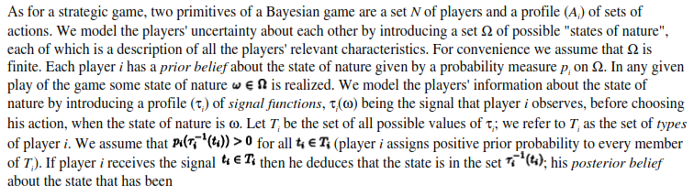
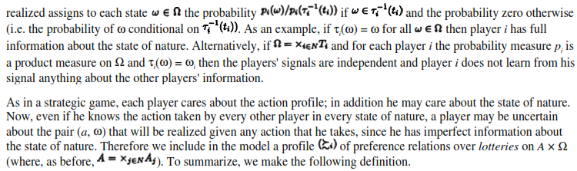
:

Slide 168
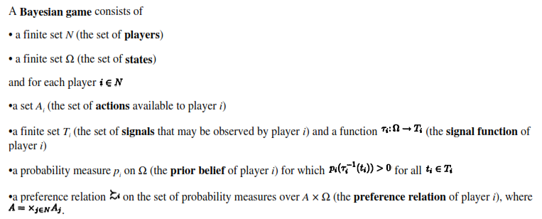
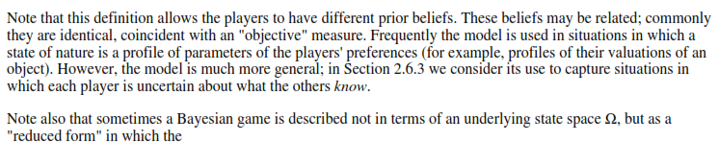

Slide 169



Slide 170



Slide 171


Slide 172
Thanks

